Slide 1

Hotel Operators Guide to AV
Every brand tries to create an experience for their customers, to connect. The ability to connect leads to long term customer loyalty, brand promotion amongst friends, family, & co-workers, and ultimately more sales and revenue for the business. The best way to connect with customers is to appeal to their senses, and make a lasting impression. For most brands they fight the challenge of short term decisions by customers, what clothes to wear, restaurants to visit, stores to shop, etc.
There are only a few personal choices that get made that lead to long term brand loyalty, their car, their home, their church, and their HOTEL. Most people will lean into a hotel brand and “try it” for a short period of time, maybe experiencing a couple different brands by the company (ie. Marriott, Hilton, Choice, Hyatt). But once they’ve made a decision to stick with a brand, they do it over and over, and for many years to follow. The loyalty programs lead to increased visits and ultimately long term, consistent brand selection by the customer. At Harman, our goal is to help Hotel operators create the desired connection by providing an amazing customer experience throughout the property utilizing audio visual solutions.

Slide 2
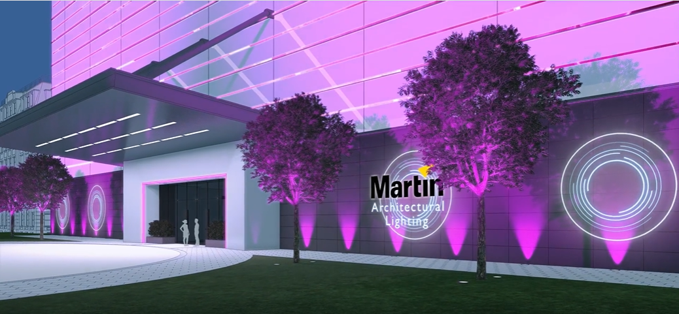
Entrance & Exterior
First impressions set the tone for the customer journey, and the Hotel entrance is your first opportunity to visually appeal to their senses through eye-catching lighting, graphics, and soothing colors that bring your property to life. Architectural Lighting by Martin has the ability to truly create that remarkable first impression. Standing out amongst the crowd of other hotel properties is essential, and with the proper lighting design we can help create a unique and dynamic experience, that will certainly be noticed.
While seeing the property from afar, and upon arrival in a new light is good for business, it’s also important to create an awesome arrival experience. Using JBL architectural all-weather speakers can provide a subtle and relaxing experience as they arrive. Choose the music that represents your brand customer as we all know the customer experience starts well before they enter the lobby.

Slide 3
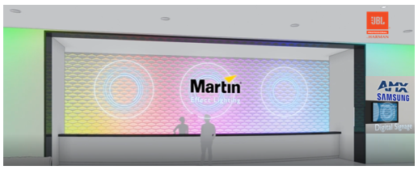
Lobby & Reception
The guest experience continues into the lobby as guests are greeted with a sensory experience like no other. Taking advantage of AMX video control & distribution, Harman can provide a Digital Signage or Video Wall solution that educates and informs your guests about the events and property offerings available to them. Many Hotel properties today use this medium as a way to advertise local community events, restaurants, shows at nearby theaters, sporting events, etc.
Your front desk is the front-line to your guests and the next most important impression you can make to make them feel welcome. Using soft wash and effect lighting along the back wall to your front desk is a simple, inexpensive way to add life to the reception desk. Martin offers all kinds of accent lighting to make your front desk stand out, be noticed, and remembered.
Throughout the lobby take advantage of JBL in-ceiling speakers to provide music the way it was meant to be heard. With crystal clear quality and perfectly balanced coverage, the guests will understand you’ve invested well in your property and in them, as your customer.

Slide 4
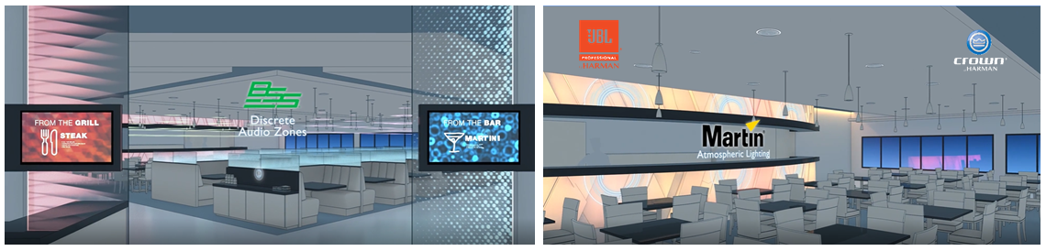
Restaurant & Dining
Harman provides more restaurant & bar AV systems around the world than any other brand on the planet, and your Hotel is no different. Allow Harman to help you create the perfect ambience utilizing JBL, BSS & Crown for sound, Martin for lighting, AMX for video distribution and scene control. By developing a partnership with Harman you have access to a complete line of products that provide the perfect synergy for the guest AV experience.
Whether it’s a quaint bistro style café, full-scale full service chophouse, a sports bar, or live performance music venue, Harman has you covered. Simply put, if you’re trying to create guest gathering place for social entertainment, we can create the perfect guest experience. Taking advantage of our network with some of the best AV design integrators in the world, we help provide the end to end solution you’re looking for from concept design to complete system implementation.

Slide 5
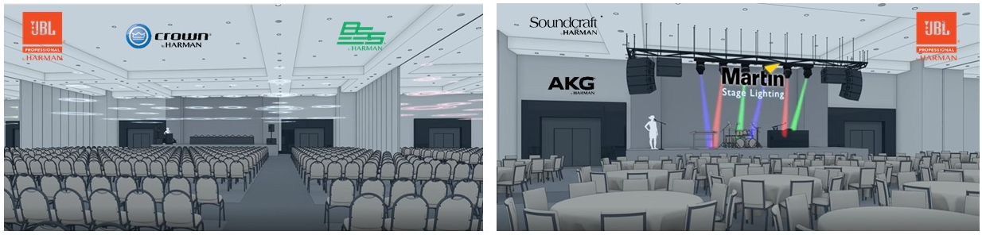
Meeting, Ballroom & Event Spaces
Hosting Corporate Events or Weddings it’s important to manage the logistics of large groups and keeping things organized is essential. Providing direction to your guests via AMX LED Panels properly placed throughout the property can simplify things for your management teams and staff. From room & space identification to lunch announcements and advertising, using LED panels can offer multiple ways to notify and update your guests. The panels come with multiple features that are Hotel specific, and available in many sizes based on the wall space you need to fill.
If your property plans to host live performance events, acoustic music sessions, comedians, DJ’s or bands, and you want to elevate the guest experience, look to Harman to get it done. We’ve designed and developed more stage and performance systems than every other company worldwide, combined. It might be a simple corner set-up by the pool or bar that provides a fun party atmosphere, or stage-type multi-purpose venue that can handle all types and sizes of audience. Regardless of the space you’re trying to fill, what it comes down to is providing quality audio and lighting experience the guests will remember, and talk about. Word of mouth advertising about the event can lead to repeat business, increased revenue, and elevated comparisons with your competition.
BSS Room-Combining Audio, JBL Ceiling Speakers, Crown Amplifiers, JBL PA Speakers, Martin Stage Lighting & Effects,
JBL Line Array Speakers, AKG Microphone Systems, and Soundcraft Mixing Consoles.

Slide 6
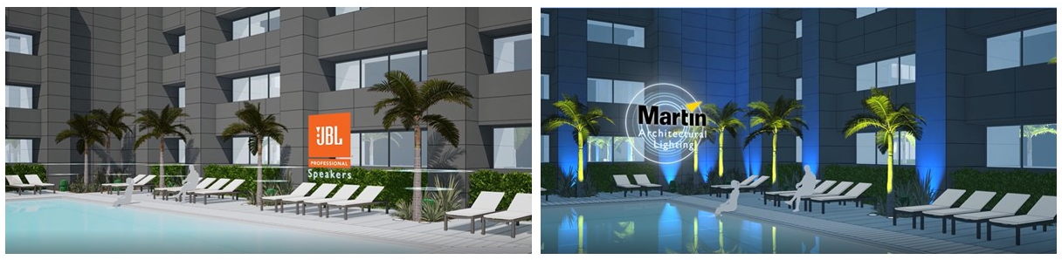
Poolside
No longer are hotel pools just bathing suits, books, and proper chlorine levels, they’re social gathering places, they’ve become places to step away from the grind to relax and unwind, or just escape for an afternoon. Offering poolside entertainment has become the norm and many hotels are developing “living room” style outdoor furniture spaces for guests to gather, drink, eat, and spend quality time together. So whether your property is known as a business hotel, or family destination, be sure to consider the value of offering an awesome pool experience.
Harman offers discreet in-ground, environmental-type weather-proof speakers that will offer great blanket coverage of the pool deck from surrounding landscape design. Combining the JBL sound with great Martin accent lighting that draws the attention of your guests will make them want to spend more quality time with family and friends, poolside, bettering their total guest experience.

Slide 7
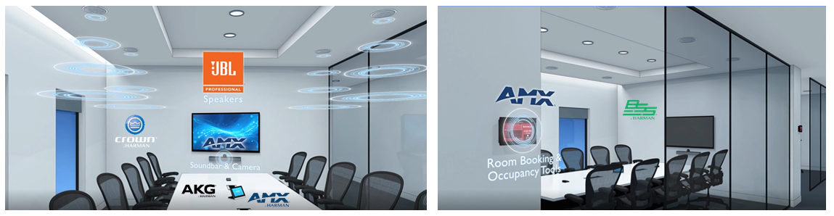
Conference Rooms
Providing a professional conferencing environments is a fundamental condition for capturing the business traveler. Offering a satellite office space for meetings and presentations is what drives their repeat business, especially when you make it super simple for them to do business at your property. No longer does the business traveler want to sit at Starbucks and compete for table space, cram-in with a laptop, and try to talk over crowds of people. The Harman conferencing systems keep the essentials in mind and offer a great solution for your guests to take advantage of. With easy-to-use Room Booking software by AMX, you can manage this service from your front desk.
The Harman in-room conferencing solutions include: AMX presentation tools like soundbars, cameras, and video conferencing make this incredibly useful space that much more dynamic for the guests. Combining JBL, BSS and AMX allows our Intelligent Conference Call systems to provide crystal clear two-way speakers and microphones to assure perfect intelligibility throughout the meeting. Finally the AMX Connectivity and Room Controls, that can be built right into the table top with touch screen to control the video, audio, and in-room lighting with the touch of a button. And when you’re done, the AMX Room Booking software allows for a quick and easy departure with one-touch shut down to clear the space.

Slide 8
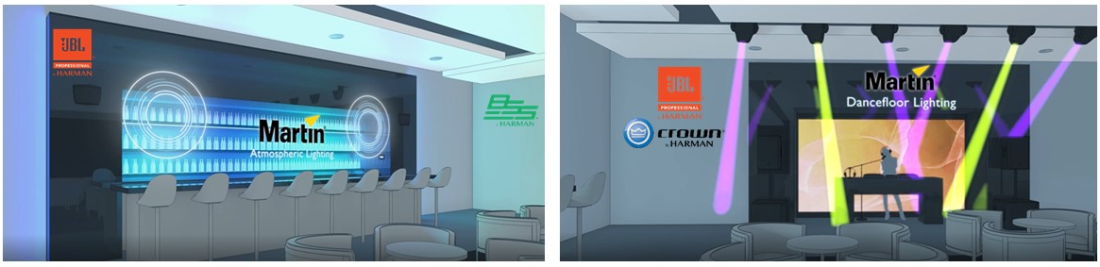
Bar, Lounge, or Club
Harman’s professional brands can create an awesome club or high-energy bar experience that rivals famous Miami night clubs every night of the week. We can help set the atmosphere to provide your guests with a one-of-a-kind club, lounge, or bar affair through our premium technologies.
Don’t just settle for standard interior lighting when you can provide a much better bar experience with our Martin Lighting packages that not only provide wall accent washes but stage and performance area lighting for DJ’s and Dance Floors. Offering something different is exactly what your property needs to thrive in a competitive landscape that is the Hotel business.
Rather than having bands or DJ’s bring in their own gear, set-up, and entertain, how about having it already on-site, installed, and ready for their use. No matter who you bring in to use the gear, you know what the experience will be for the guests. Improved brand consistency develops when your guests relate to your Hotel and look forward to returning.
With our premium audio solutions like JBL, Crown, BSS, dbx, AKG, and Studer, it simply doesn’t get any better. Your guests will remember their time spent at your property, guaranteed.

Slide 9
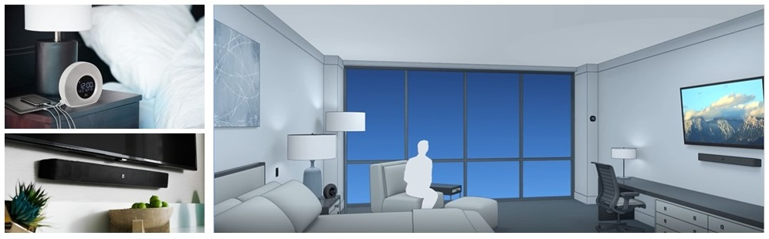
Guest Rooms
Harman’s professional brands are typically used throughout the rest of the property, as they are used to entertain and inform guests during their stay. Well now we introduce a few more products to the line that improve the guest experience, in the rooms.
Introducing the JBL Horizon Clocks and JBL Soundbars. Our new bedside clocks, the JBL Horizon, have integrated ambient lighting, Bluetooth connectivity, simple single alarm, and USB charging stations for the guests. They are small, sleek, and come with incredible JBL sound quality speakers to provide your guest rooms with an awesome audio experience.
The JBL soundbars offered by our Lifestyle division have been modified for the Hotel guest rooms to connect simply to your in-room Televisions. The soundbars help avoid sound transference from room-to-room, where guests can hear one another, or their televisions in the room next door. The JBL soundbars have volume limiting features designed for guest rooms so not to disturb the surrounding rooms, as well as simple TV connectivity and universal remotes to allow for TV audio control through the soundbar.

